Slide 1

#DataSeries18
Raihan Pratama
Predicting Student Scores Based on Study Hours using Machine Learning Models

Slide 2
#DataSeries18
What Is Machine Learning?
MACHINE LEARNING (ML) is a way for computers to 'learn' from experience (data) and make predictions or decisions, without having to be constantly instructed by humans. In other words, the more 'training' a computer receives, the smarter it becomes at recognizing patterns, making decisions, or predicting things.

Slide 3
#DataSeries18
What Is Student Scores dataset?
The Student Scores dataset is a commonly used dataset in machine learning for regression tasks. The objective is to predict a student's exam score based on the number of hours studied.
This dataset is often used in educational research and machine learning tutorials. Although it's not directly available in Scikit-Learn, it can easily be found on platforms like Kaggle or in various educational datasets.

Slide 4
#DataSeries18
Why Is This Dataset Important?
The Student Scores dataset is important for evaluating machine learning algorithms in educational prediction tasks. By predicting student exam scores based on the number of hours studied, it helps in understanding the relationship between study time and academic performance. This dataset is a great choice for testing various regression models efficiently.

Slide 5
#DataSeries18
What Is The Purpose Of This Project?
The Student Scores dataset is used to evaluate and compare various machine learning algorithms to predict student test scores based on the number of study hours. The goal of this project is to build the most accurate model to predict student performance, which can help identify study patterns.

Slide 6
#DataSeries18
Get Started

Slide 7







#DataSeries18
Tools and Libraries

Slide 8
#DataSeries18
table of contents
Import Libraries
Import Dataset
Exploratory Data Analysis (EDA) and Features Engineering
Preparation Data, Split Data and Feature Scaling
Model Evaluation
Train The Model
Visualization and Model Comparison
Conclusion

Slide 9
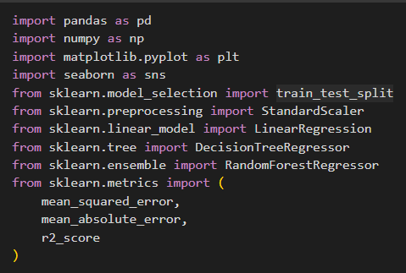
#DataSeries18
Import Libraries
In this project, we use essential Python libraries such as Pandas for data manipulation, NumPy for numerical operations, and Matplotlib and Seaborn for data visualization. For building and evaluating machine learning models, we leverage Scikit-learn, including algorithms like Linear Regression, Decision Tree, and Random Forest, along with metrics such as Mean Squared Error and R² Score to assess model performance.

Slide 10

#DataSeries18
Import Dataset
In this step, we import the dataset using Pandas with the function pd.read_csv(). This allows us to load the Student Scores data from a CSV file called 'student_scores.csv' into a DataFrame (df) for further analysis and model building.

Slide 11
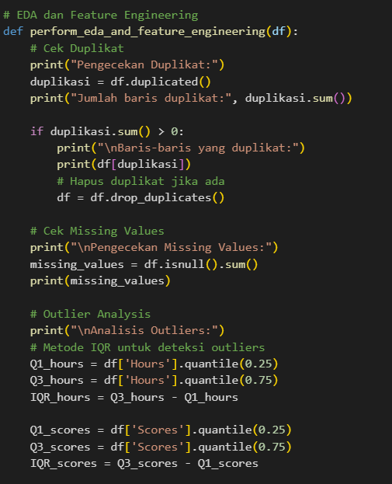
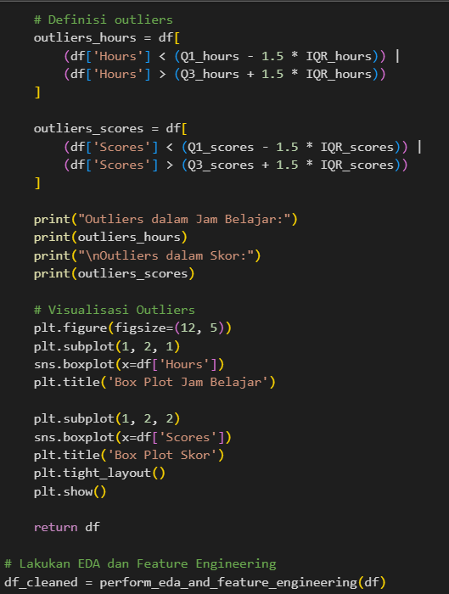
#DataSeries18
Exploratory Data Analysis (EDA)
In this step, we perform Exploratory Data Analysis (EDA) and Feature Engineering to clean and prepare the dataset. First, we check for duplicate entries and remove them if found. Next, we inspect for missing values in the data. We also analyze outliers in both the Hours and Scores columns using the Interquartile Range (IQR) method, and visualize them with box plots to understand their impact on the data. The cleaned dataset is then returned for further modeling.

Slide 12
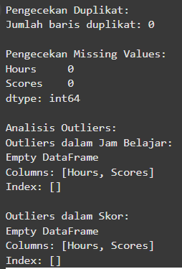
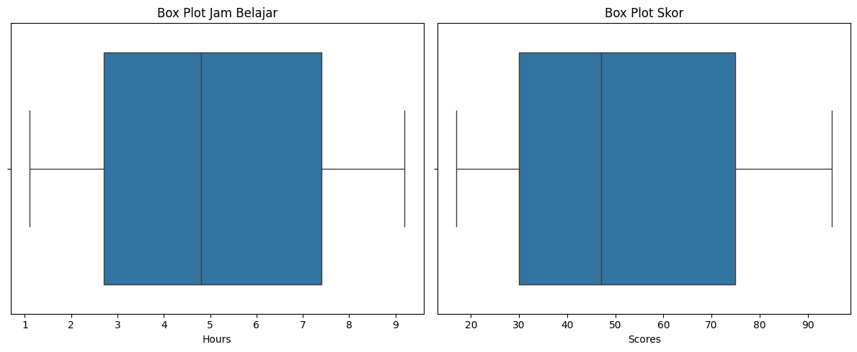
#DataSeries18
Result

Slide 13
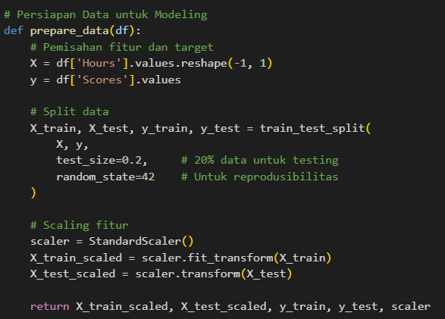
#DataSeries18
Preparation Data, Split Data and Feature Scaling
In this step, we prepare the data for modeling by splitting it into features (X) and target (y). We then split the data into training and testing sets, with 20% allocated for testing to evaluate the model's performance. To ensure the model works efficiently, we apply feature scaling using StandardScaler to standardize the data, making it easier for the model to process and improve accuracy. The scaled training and testing data are returned for use in modeling.

Slide 14
#DataSeries18
Train the Model, Evaluation and Visualization
Decision Tree
Linear Regression
Random Forest

Slide 15
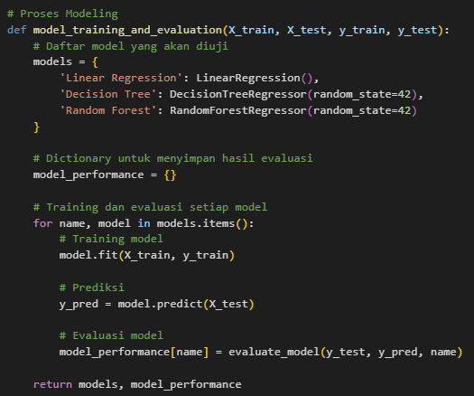
#DataSeries18
Train the model
In this step, we train and evaluate three different machine learning models: Linear Regression, Decision Tree, and Random Forest. The models are trained using the training data (X_train and y_train) and then evaluated using the testing data (X_test). Predictions are made for the test set, and the performance of each model is stored for comparison. This helps in selecting the best-performing model for predicting student scores.

Slide 16
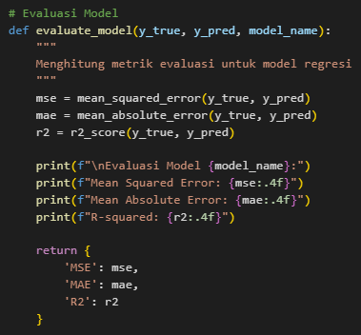
#DataSeries18
Model Evaluation
In this step, we evaluate the performance of the trained models by calculating three key metrics for regression tasks: Mean Squared Error (MSE), Mean Absolute Error (MAE), and R-squared (R²). These metrics help assess how well the model predicts student scores compared to the actual values. The results are printed for each model to facilitate comparison and selection of the best-performing model.

Slide 17
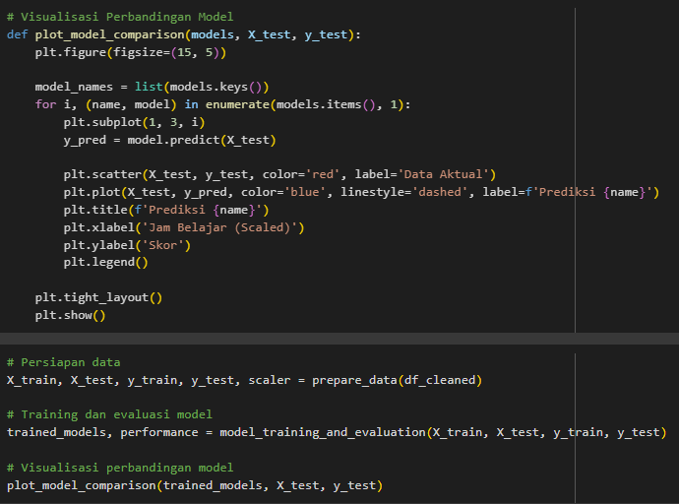
#DataSeries18
Model Evaluation
In this step, we evaluate the performance of the trained models by calculating three key metrics for regression tasks: Mean Squared Error (MSE), Mean Absolute Error (MAE), and R-squared (R²). These metrics help assess how well the model predicts student scores compared to the actual values. The results are printed for each model to facilitate comparison and selection of the best-performing model.

Slide 18
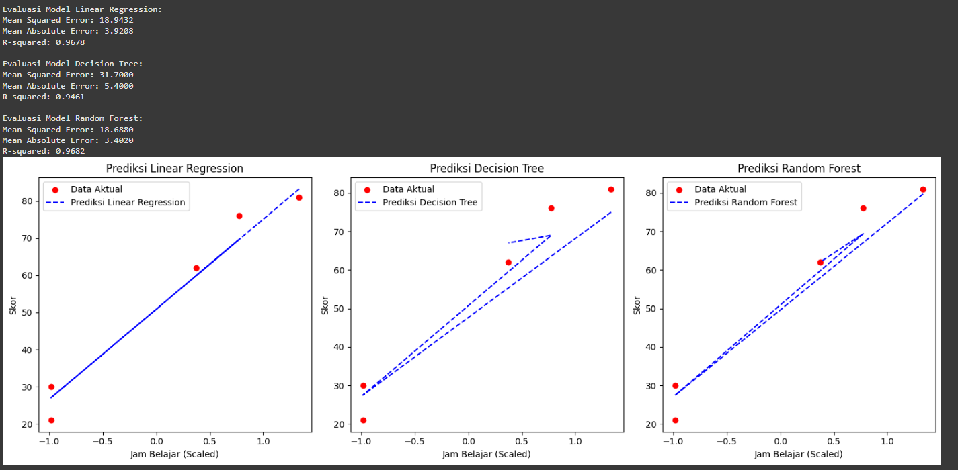
#DataSeries18
Result

Slide 19
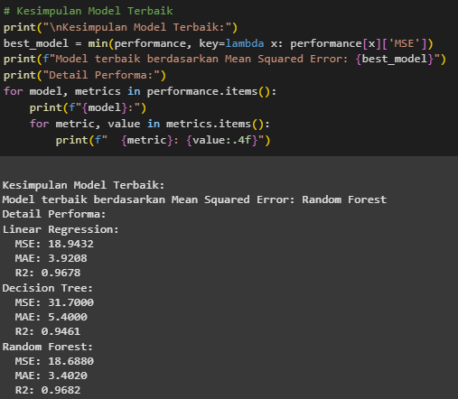
#DataSeries18
Model Evaluation
In this step, we determine and summarize the best model based on the lowest Mean Squared Error (MSE). The model with the best performance is selected, and its metrics are displayed to provide a detailed evaluation of each model's accuracy. This helps to identify the most effective model for predicting student scores.

Slide 20
#DataSeries18
Conclusion
Based on the analysis and comparison of three machine learning algorithms—Linear Regression, Decision Tree, and Random Forest—Random Forest showed the best performance with the lowest Mean Squared Error (MSE) of 18.6880, followed by Linear Regression with 18.9432 and Decision Tree with 31.7000. All models showed a reasonable fit to the data, but Random Forest had the highest R-squared (R²) value of 0.9682, indicating that it explained the most variance in student scores. Overall, Random Forest is the best choice for predicting student scores, but Linear Regression is a good alternative when interpretability and simplicity are preferred.

Slide 21

#DataSeries18
THANK YOU

